Slide 1
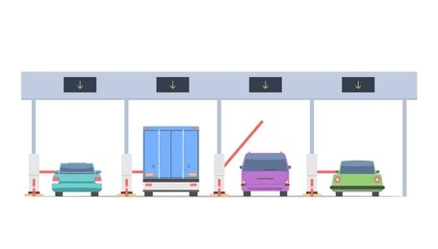
Toll Plaza System CS-412(Group-G).
Tool Plaza Also Called Tool Gate

Slide 2
Project Members
M Jameel Ur Rehman (2022-ag-8615).
Muhammad Jabbar (2022-ag-8601).
Muhammad Ahmer (2022-ag-8574).
Muhammad Anees (2022-ag-8620).

Slide 3
Features
Main Form 1:
Main Form has three features:
It is also known as “WELCOME!” Screen.
It is used to access other forms.
It has three buttons.
New Vehicle
New Tool
New Records

Slide 4
Vehicle Registration Form:
This form has functionalities like “Insert”, “Delete” newly entered data from the database.
Speaking of database it is connected to a database file.
It is also used to enter vehicle name, vehicle number and vehicle type and toll amount of that vehicle.
The “Update” feature only used to update toll amount because the amount can be extend by the government policies.

Slide 5
Toll Collection Form:
It is also connected to another database file.
It also enter and save vehicle’s data but only its number, entering time, leaving time and toll amount.
It can delete any record that is entered.
It can generate a bill and can print it.
It can reset the voucher.

Slide 6
Records Form:
I this final form we again access a database file that is connected to the “Vehicle Registration Form”.
We show the file in the grid view.
Now, we calculate and then show the total cars from one of the columns “VEHICLENAME” in the database file into the one of the textboxes.
Now, we calculate and then show the total amount from one of the columns “TOLLAMOUNT” in the database file into the one of the textboxes.

Slide 7


